Slide 1
Understanding Sepsis
Ben Ryrie

Slide 2
Content
35 mins in the life of a crew
Sepsis in the UK
Physiology – Normal
Symptoms
A set of abnormal Obs
Physiology – Abnormal
Who is at risk?
Assessment tool
Action
Patient Recovery

Slide 3
35 mins in the life of a crew
Minute
0 | Call comes through as DIB at a GP surgery
4 | Arrive at pt side and primary survey – GP assessed and on 28% mask 4 ltr. GCS 15. talking but (AVPU)
5 | History given – Chest infection 10 days – antibiotics from day 2 – 8.
6-8 | Assessment and Obs taken
8 | Rapid transfer to A&E agreed.
8-12 | Extraction to Ambo and dealing with the relatives (AVPU)
12-19 | Travel on blues to LRI with pre-alert - (AVPU)
19 | Cardiac Arrest – CPR started on the back of Ambo at A&E
20 | Pt handed over in LRI resus
35 | Patient dead
What are your thoughts?

Slide 4
Sepsis in the UK
UK mortality rate for patients admitted with sepsis is 30%
  approximately 5 times higher than for STEMI and stroke
123,000 cases - 44,000 deaths and 150,000 hospital admissions
In 2007 in the UK, sepsis was found to
account for 12% of early inpatient deaths after ED admission
Hospitalizations for sepsis have more than doubled over the last 10 years
For every hour that appropriate antibiotic administration is delayed, there is an 8% increase in mortality.

Slide 5
Physiology -
Normal for an infection
Infection/damage to tissue
  Caused by e.g. Trauma, toxins, heat.
Cells release
  histamine, bradykinin, and prostaglandins
= increase to blood supply supporting the immune system.
What is immediately obvious to a responder assessing this?
What two reasons why you think it does this?
Swelling
Redness
Warmth
Pain
Attack the infection or foreign body
Contain the problem.

Slide 6
A set of abnormal Obs
For Adult Red Flag Sepsis – What could the Obs look like
Complete the Obs sheet and then we will discuss.

Slide 7
ACVPUssion
Level of consciousness:
. Was
Now
A
Alert
V
Verbal
P
Pain
U
Unresponsive
A
Alert
V
Verbal
P
Pain
U
Unresponsive
C
Confusion

Slide 8
A set of abnormal Obs
Pulse
Respiratory Rate
Temp
BM
BP
Pupils
Sats
130 + - Cap refil >3s
25+
Anything – high or low
Anything
< 91 systolic
PEARL
<94%
ACVPU
C, V, P, or U

Slide 9
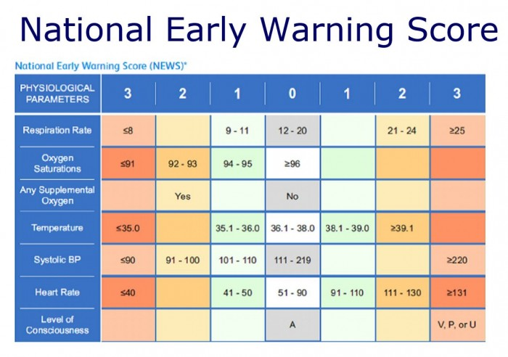
NEWS

Slide 10
Septic Shock
Infection spreads via CVS
Causing inflammation symptoms throughout body
BP low
Interrupts blood supply
O2 to organs and tissue reduces
Septic shock
Low BP = abnormal cellular Metabolism = Organ failure

Slide 11


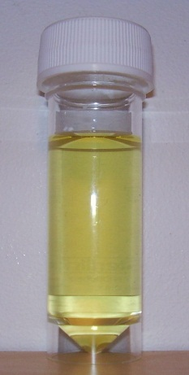
INTERESTING FACTS
The most common infective cause of sepsis is:
Pneumonia (community acquired) 55-60%.
    Gastro-intestinal infections 25%.
    Others are made up of urinary tract infections,
    soft tissue and bone infections 15-20 %.

Slide 12
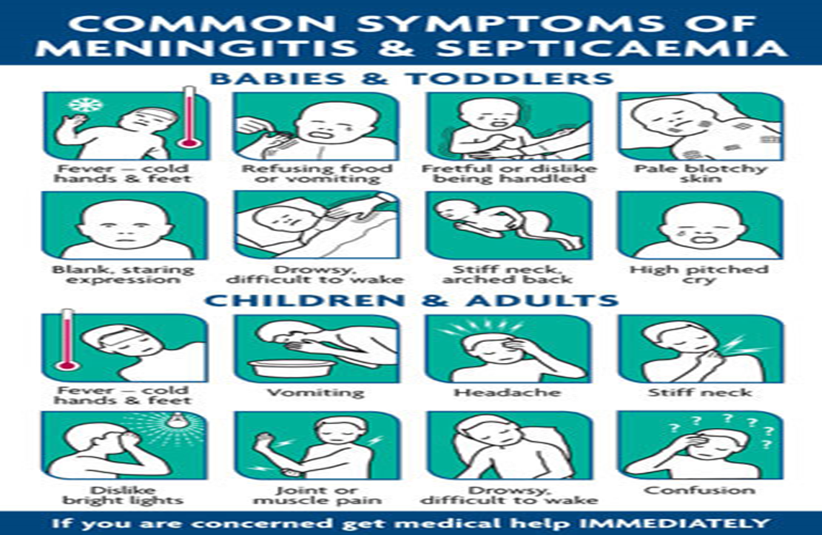
Meningitis symptoms

Slide 13
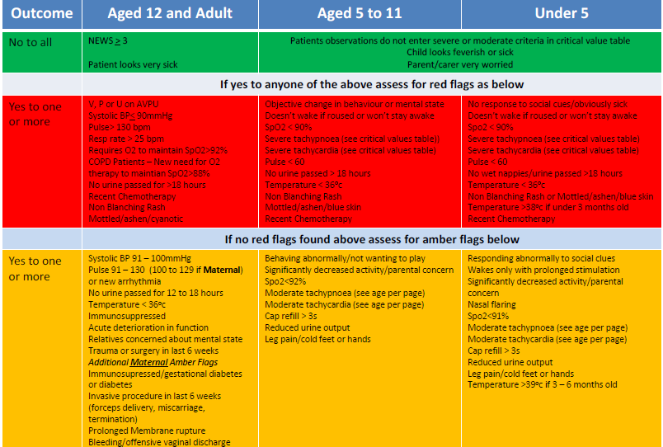
Sepsis Toolkit

Slide 14
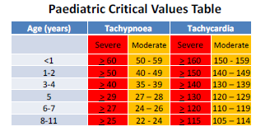
What should I do?
Yellow – Sepsis Likely
Green - Low Risk of Sepsis
News greater than 4 – ring for the CAT team.
Low risk sepsis can sometimes be treated in the community however it should still be treated with urgency. Without treatment low risk sepsis is likely to progress , sometimes rapidly, particularly in high risk groups of patients such as the elderly, the very young or those with a low threshold for infection – If uncertain ring the CAT desk as per Yellow.
Red Flag Sepsis
Do. Ask for a call back from CAT stating that you have red flag sepsis. Get History, NEWS and obs ready.
Do. Place pt on O2 15Ltrs NRB – until vital signs normal
Consider other interventions e.g. Salbutamol if indicated.
Consider. Patient position
Consider. Place pt on O2 until vital signs normal
Consider other interventions e.g. Salbutamol if indicated.
Consider. Patient position

