Slide 1

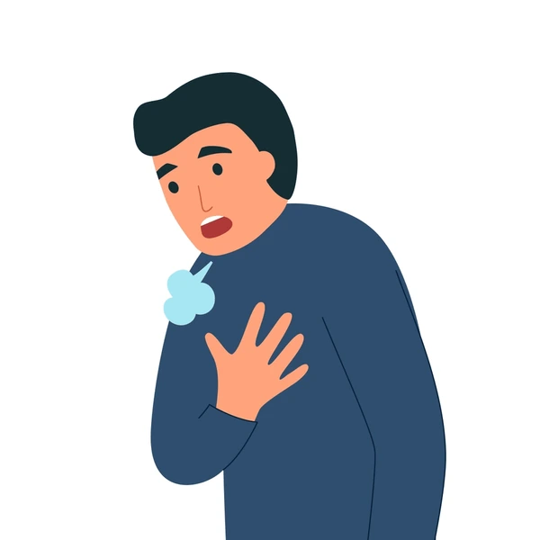
Breathing Difficulties
Respiratory conditions and treatments

Slide 2
What are some respiratory conditions/diseases?
Notes:
Name conditions/diseases: asthma, copd, pneumonia, bronchitis, pulmonary embolism, pulmonary fibrosis

Slide 3
Respiratory conditions/diseases:
Asthma
COPD
Pneumonia – infection in the lungs (alveoli)
Pulmonary embolism (PE) – blood clot in the lungs
Notes:
Mention we wont go into detail on bronchitis, pneumonia or pe – just nice to know what these conditions are if a pt mentions they suffer with them.
Bronchitis – inflammation of the bronchial tubes causing thick mucus build up
PE – blood clot in the lung – signs include dib, chest pain, coughing blood, swelling in legs – something to be aware of

Slide 4
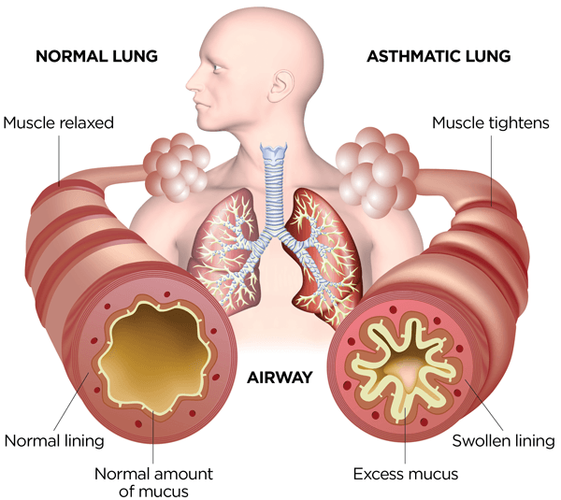
Asthma

Slide 5
What is Asthma?
Asthma is chronic respiratory condition, where the airways become inflamed causing the airway to become narrow and produce excess mucus
Notes:
Asthma is an inflammation of the bronchi causing them to narrow – the muscles around the bronchi become irritated and contract – producing excess sputum and mucus blocking airways

Slide 6

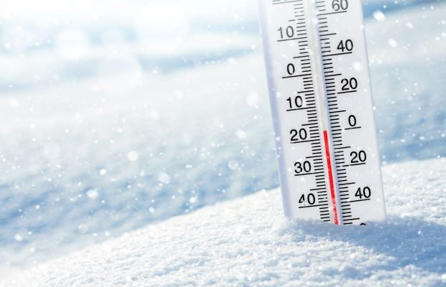

Triggers
Triggers of an asthma attack can include:

Slide 7

How is Asthma normally managed?
People who suffer with asthma normally carry their own inhalers to help minimise symptoms.
The most common inhalers are:
Brown inhaler – the ‘preventer’ which is an anti-inflammatory
Blue inhaler – the ‘reliever’ which is a bronchodilator
Notes:
The brown inhaler is used daily, to prevent symptoms by reducing airway inflammation – contains a steroid. The blue inhaler is used to relieve symptoms quickly, when symptoms are worsening or pt may be experiencing an asthma attack – it relaxes the muscles – contains salbutamol

Slide 8
Asthma Attack
Signs and symptoms (worsening of and not relieved by own inhaler):
Wheezing
Shortness of breath
Difficulty in breathing
Worsening cough
Tight chest/chest pain
Notes:
Mention that these can be normal signs of asthma, however if they feel worse then usual for the pt and/or not being relieved by own inhalers then this could be a sign of an asthma attack. Usually the pt knows what is normal for them

Slide 9
What to do…
The patient can use their blue inhaler up to 10 times (10 puffs) waiting 30 to 60 seconds in between each puff.
If this hasn’t worked consider coaching breathing and prepare a nebuliser.
Notes:
Normally the pt will have used their inhaler 10 times before calling ambulance, but if not, encourage to do this first
Try to coach patients breathing and set up a nebuliser which will be discussed further on in the powerpoint
Beware that prolonged use of blue inhaler can caused increased side effects scuh as fast HR and shakiness

Slide 10
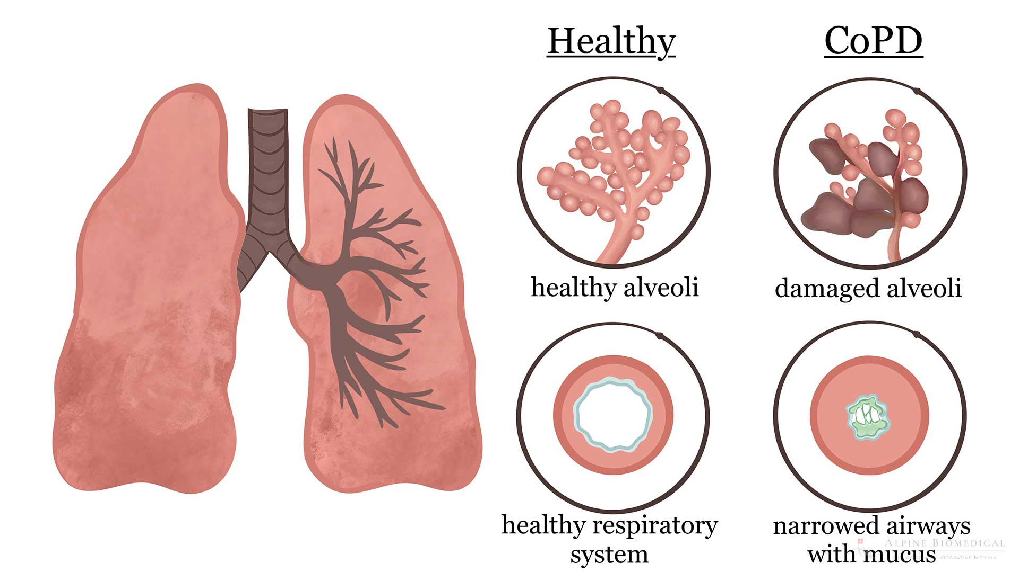
COPD

Slide 11
What is COPD?
Chronic obstructive pulmonary disease (COPD) is the name for a group of lung conditions that cause breathing difficulties.
It includes:
Emphysema – damage to the air sacs in the lungs
Chronic bronchitis – long-term inflammation of the airways

Slide 12
Exacerbation of COPD
Signs and symptoms (worsening of):
Shortness of breath/breathlessness
Difficulty in breathing
Chest tightness or pain
Wheezing
Changes in cough and mucus production
Notes:
Treatment? Nebulise!

Slide 13
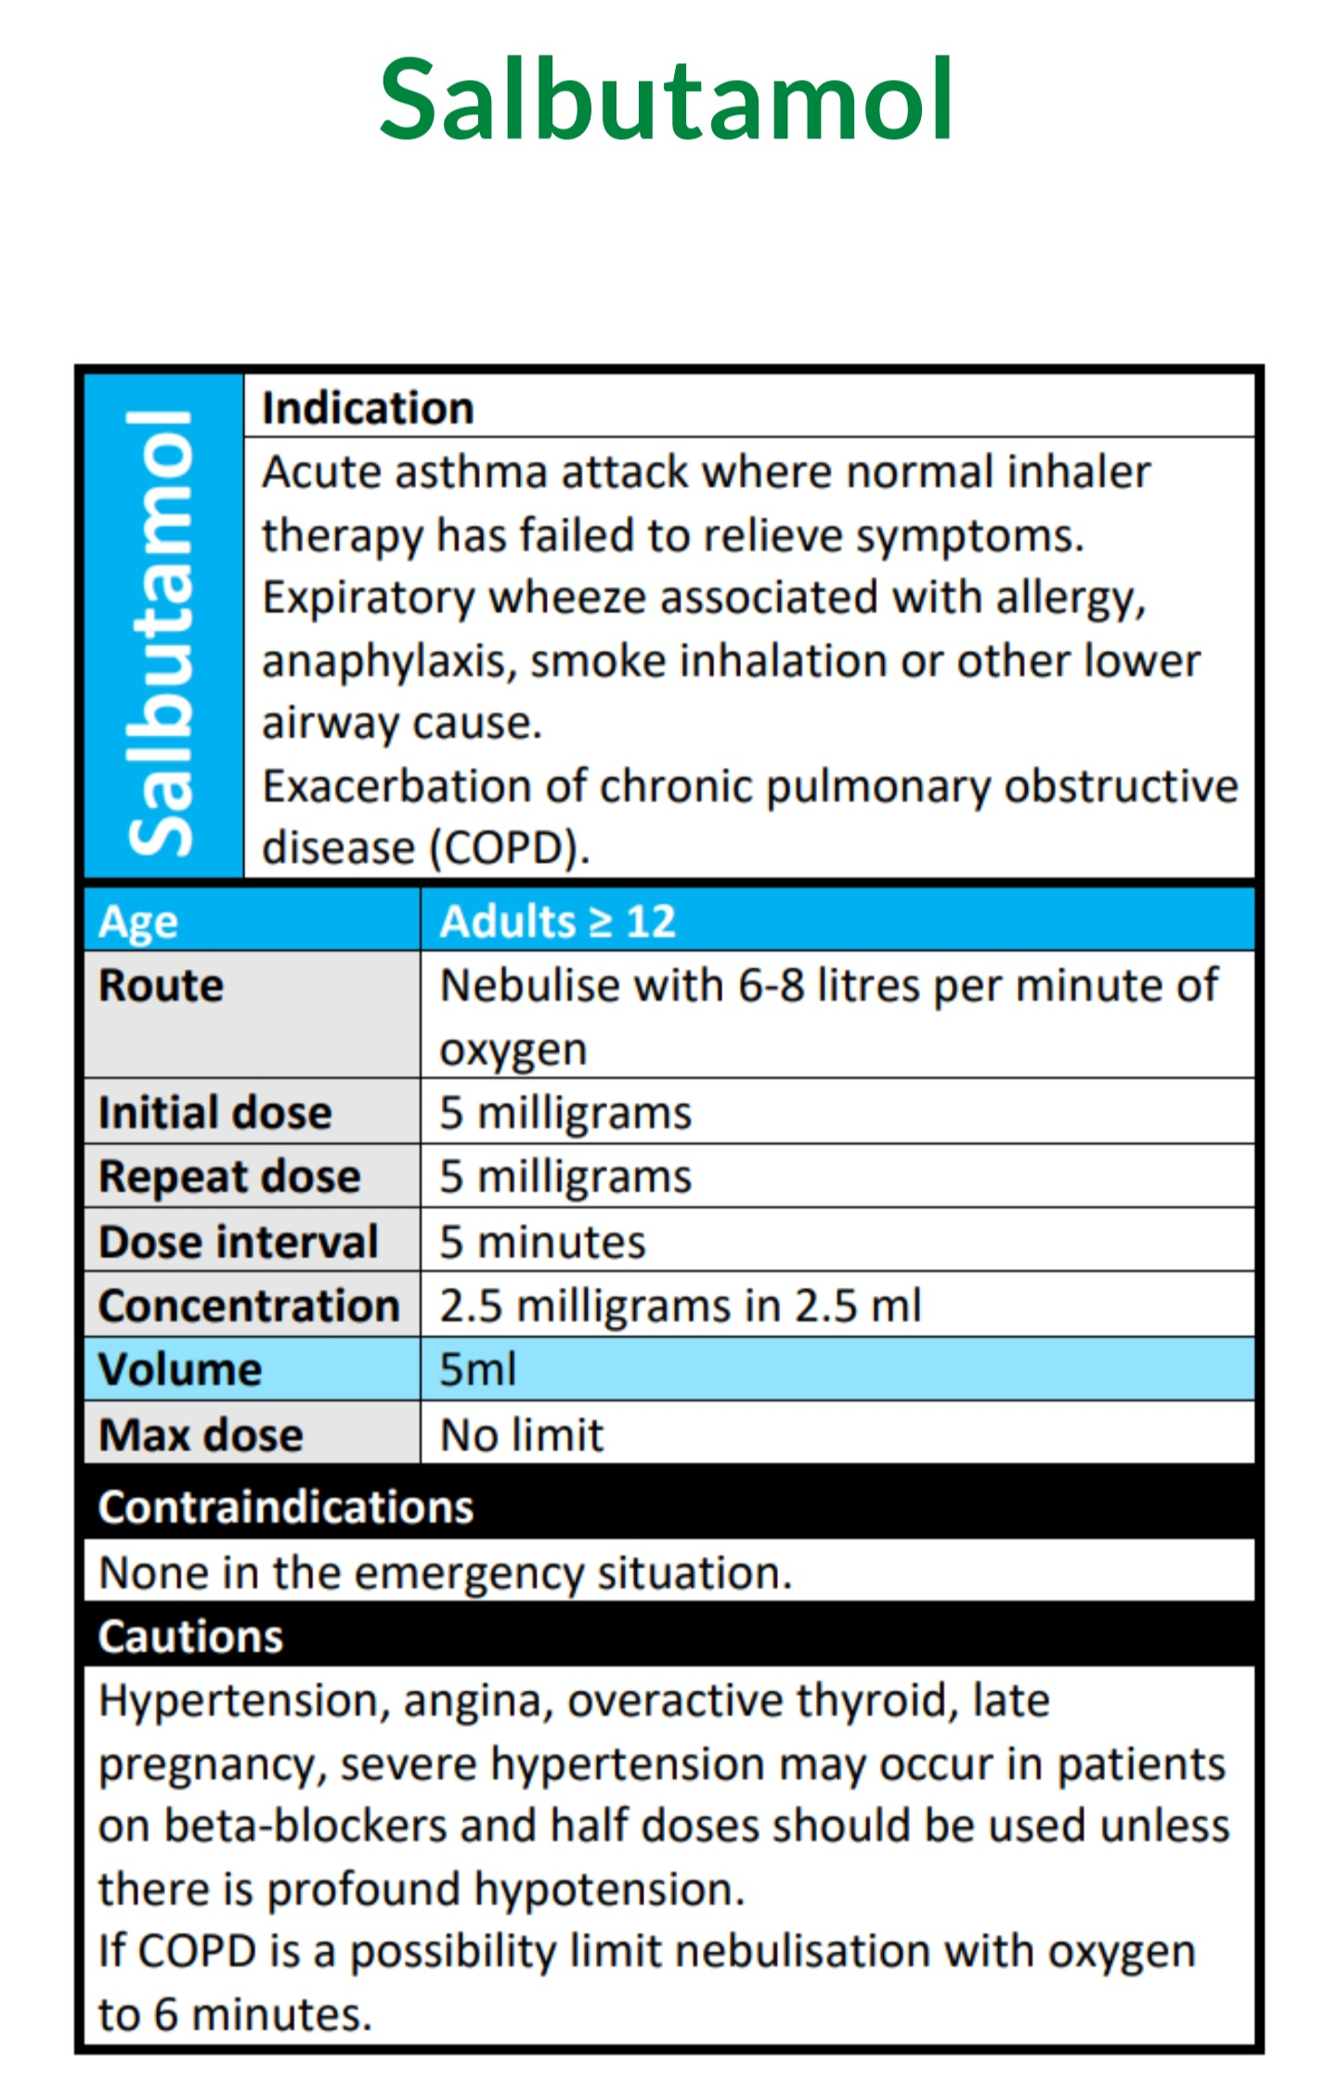
Nebulising

