Slide 1
Paediatric BLS
John Whittaker

Slide 2
RESPIRATORY RATES
< 1 30 -40 breaths/min
1-2 25-35 breaths/min
2-5 25-30 breaths/min
5-12 20-25 breaths/min
>12 15-20 breaths/min

Slide 3
Age related terms.
Infants: from birth to 12 months of age – in the first 4 weeks after birth may also be called neonates
Toddler: approx 1-2 yrs of age
Pre school : 2-5 yrs of age
School age : 5-12 yrs
Teenager: onset of puberty to 18 yrs of age

Slide 4
Anatomy – some differences
Airway:
  Faces – Small - Mask sizing important for good seal
  Nose – 0 – 6 months

Slide 5
Anatomy – some differences
Breathing:
  O2
    Small O2 reserves
    High CO2 production
    Higher O2 demands
    Any compromise = quick O2 decline
    O2 therapy vital.
  Muscular/skeletal
    Infant Ribs = cartilaginous
    Weak Intercostal Muscles - more likely recession

Slide 6
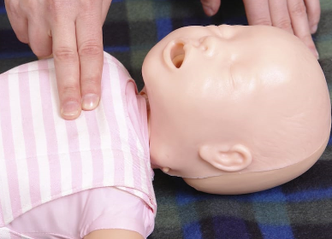
Paediatric BLS/AED

Slide 7
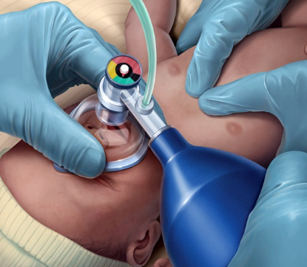
CPR – under 1 yr
Check for signs of life/circulation.
<60 beats/min = CPR
If none = CPR
5 initial rescue breaths
Check breathing
15:2 – 1/3 depth
Full release
100/120 compression/min
Tips of 2 fingers (infant)
1 finger’s width above the base of the Sternum.
2 rescuers = option of encircling technique
AED TO BE USED AS SOON AS POSSIBLE AFTER THE FIRST CYCLE OF CPR

Slide 8
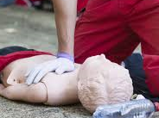
CPR – over 1 yr
Check for signs of life/circulation.
<60 beats/min = CPR
If none = CPR
5 initial Rescue breaths
Check breathing
15:2 – 1/3 depth
Full release
100/120 compression/min
One hand (child)
1 finger’s width above the base of the Sternum.
2 rescuers = option of encircling technique
AED TO BE USED AS SOON AS POSSIBLE AFTER THE FIRST CYCLE OFCPR

Slide 9
CPR – practice
Practice time
Both infant and child CPR
Use of BVM to be included

Slide 10
Recognising a sick child:
Primary Survey

Slide 11
Primary Survey
DRccABC
Plus
General impression
  Paediatric Assessment Triangle

Slide 12
The General impression
Appearance
T
Tone = Spontaneous movement or floppy
I
Interactive = responds to people, objects or sounds
C
Consolability = Can they be by Carers/Parents
L
Look/Gaze = Look at you or glass eyed stare
S
Speech/cry = Cry strong or weak.

Slide 13
The General impression
Work of breathing
  Look = work/effort
  Listen = abnormal sounds
Sounds
Position
Recession
Snoring
Striddor
Grunting
Wheezing
Sniffing the morning air
Tripod
Refusing to lie down
> 5s = greater risk
Flaring
Nasal flaring exaggerated opening
Head bobbing - infants

Slide 14
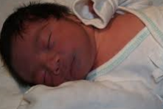
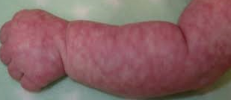
The General impression
Circulation to skin
  During a serious illness skin is a none essential organs
  Look for
    Pallor – reflex shunting of blood away from skin.
    Cyanosis (<2months hands and feet = normal)
    Mottling (normal in cold conditions)

Slide 15
Recognising a sick child:
Secondary Survey

Slide 16
Breathing
Look
Chest movement
Listen
At the mouth/nose
Feel
At the mouth
Normal/abnormal
Sounds

Slide 17
Breathing
Observation of a child’s breathing quickly indicates the adequacy of their oxygenation and ventilation .
LOOK AT: EFFORT- Does breathing seem easy, or laboured?
RECESSION- Present or not? > 5yrs??
POSITION- Is the child adopting the tripod position?

Slide 18
Breathing Sounds
Listen for:
STRIDOR- usually indicates upper airway compromise
WHEEZE- usually indicates lower airway compromise
GRUNTING- An attempt by the child to keep their airways open

